Slide 1
Isolated Database Environments
Kevin Howell
February 2014

Slide 2
Agenda
Why?
Implementation Process
Pre – Isolated Database Environment Workflow
  Schema & Data Workflow
  Manual Source Control
    Red Gate (Management Studio)
    TFS (Visual Studio)
Isolated Database Environment
  Schema & Data Lifecycle
  TFS – Central to Local Repository Automation
  TFS – Local Repository to Database Automation
  Red Gate - Database to Database Automation

Slide 3
IDBE – Why?
  Driven by Agile software development
    Incremental development by Iterations
    Teamwork & Collaboration
  Allow developers to work on specific tasks independent of external changes
  Facilitates loss-free integration with modified environments after development is complete
  Provide versioning of schema to provide rollback capability

Slide 4
Implementation Process
Determine which processes need to be reproducible in a development environment
Run traces against the existing test environment to determine databases, schema and data that will be needed
Create a TFS solution with the baseline databases and schema
Implement a process to move objects and data between the development server, TFS and the developer machine

Slide 5
Schema & Data Workflow
Pre – Isolated Database Environment
Development
Testing
Staging
Production

Slide 6
Manual Source Control
Red Gate (Management Studio)
  Visual indication of changes on shared SQL Server
  Review & Commit changes by database
  Allows source control of lookup table data

Slide 7
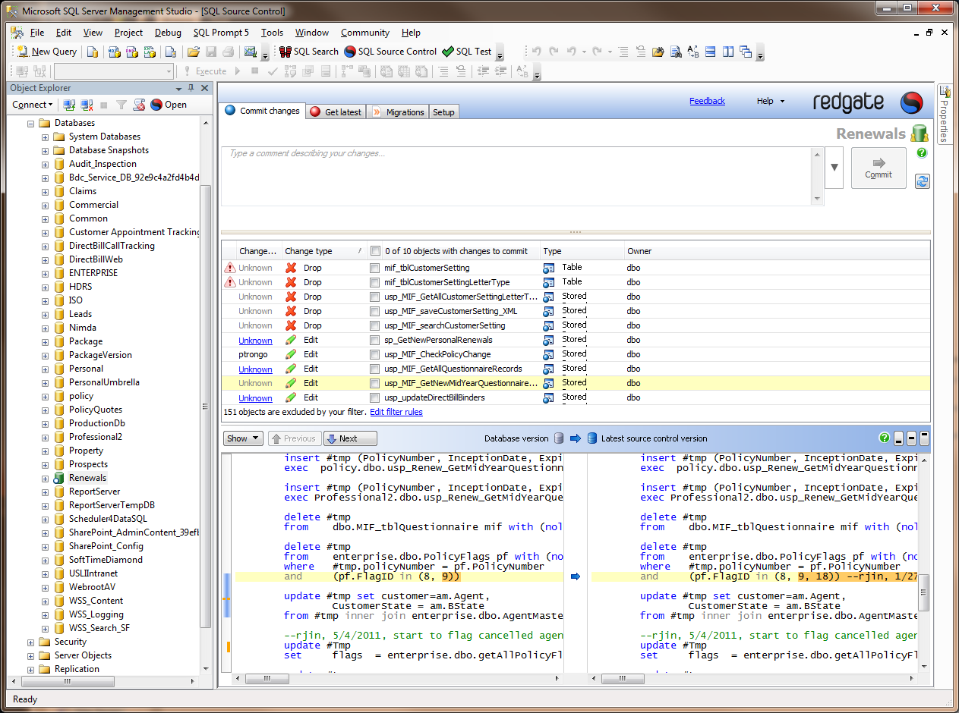
Red Gate (Management Studio)

Slide 8
Manual Source Control
TFS (Visual Studio)
  Allows both code and database development in a single environment
  Follows the TFS practices of source control for version tracking and management
  Entire project or server can be updated or committed to the central repository

Slide 9
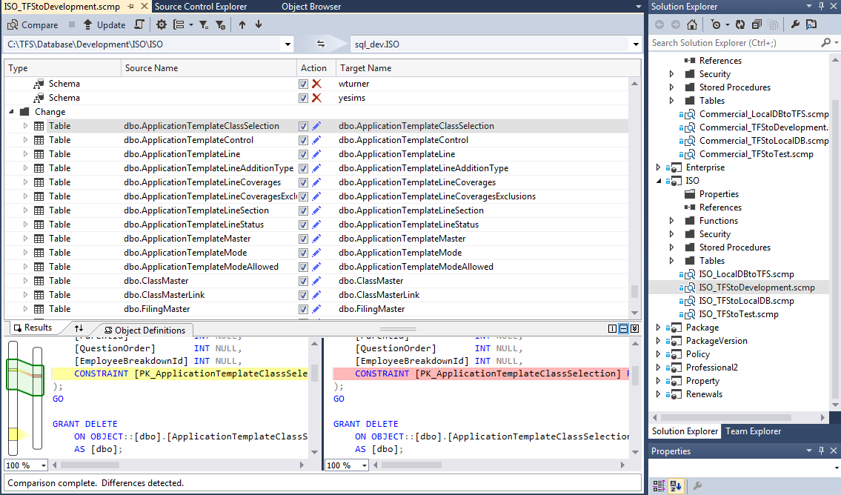
TFS (Visual Studio)

Slide 10
Schema & Data Lifecycle
  (1) The developer environment will be updated with the latest schema and data from the control repositories. This is accomplished with a .NET utility which will run all 3 parts in succession.
    (a) Move the schema changes from the central TFS repository to the local TFS repository for all databases
    (b) Move the schema changes from the local TFS repository to the local databases
    (c) Move the data changes from the central development databases to the local databases
  (2) Developer will develop in either Visual Studio or SSMS and maintain their local TFS repository for further promotion. It is the responsibility of the developer to keep the local database and the local TFS repository in sync for all schema changes.
  (3) Developer will push any schema changes to the central TFS repository when changes have been unit tested and ready for integration and regression testing
  (4) An automated nightly process will push the schema changes from the central TFS repository to the central development database
  (5) Developer will manually push any data changes to the central development database for further testing

Slide 11
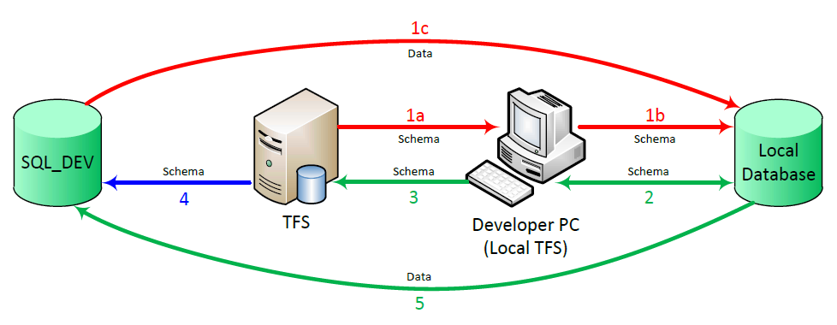
Schema & Data Lifecycle

Slide 12
(1a) TFS
Central to Local Repository Automation
Use Team Foundation Clients in Visual Studio
Get the latest version of source code (schema) from the TFS repository
Need 3 references and declarations added to project
  Microsoft.TeamFoundation.Client
  Microsoft.TeamFoundation.VersionControl.Client
  System.IO

Slide 13
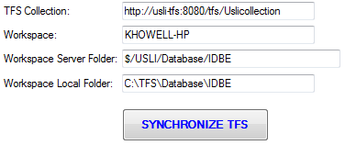
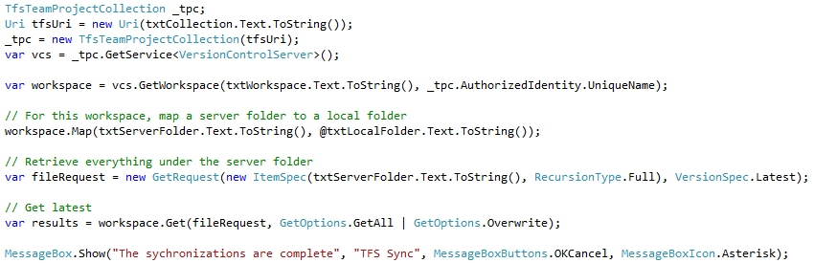
(1a) TFS
Central to Local Repository Automation
Form
Code

Slide 14
(1b) TFS
Local Repository to Database Automation
Command Line call to publish from a DACPAC file to a SQL Server database
For Visual Studio 2010 and before, use VSDBCMD.EXE
For Visual Studio 2012 and later, use SQLPackage.EXE
  Located in C:\Program Files\Microsoft SQL Server\110\DAC\bin or C:\Program Files (x86)\Microsoft SQL Server\110\DAC\bin
Need 2 references and declarations added to project
  Microsoft.Build.Evaluation
  Microsoft.Build.Logging

Slide 15
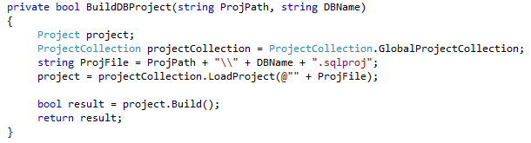

(1b) TFS
Local Repository to Database Automation
First Build the project:
Then deploy with SQLPackage Command line utility:

Slide 16
(1c) Red Gate Automation
Database to Database
  Command line utility (Pro Version)
  Can log changes for schema updates (not data)
  Use <include> tags to designate objects for comparison
  The <include> will include any objects containing the string
  The <exclude> tag will explicitly exclude objects
  Use the <synchronize/> tag to execute the comparison update

Slide 17
(1c) Red Gate Automation
Command Line Example

Slide 18
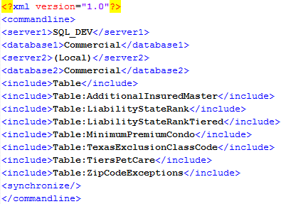
Red Gate Automation - Data

Slide 19
Conclusion
The IDBE project will provide independent development opportunities for large team collaboration, while adding security of source control and details about schema changes
This project and workflow is a work in progress
We have proof-of-concept near completion, and will be implementing soon
Any suggestions or questions are welcome:
  Email: redkev1@yahoo.com

Slide 20
References
Walkthrough: Comparing the Schemas of a Database and Database Project:
  http://msdn.microsoft.com/en-us/library/aa833202(v=vs.100).aspx
Build and Deploy Databases to an Isolated Development Environment:
  http://msdn.microsoft.com/en-us/library/dd193409.aspx
How to: Configure Deployment Settings for Database and Server Projects:
  http://msdn.microsoft.com/en-us/library/dd193254.aspx
VSDBCMD: Create a .dbschema File from an Existing Database:
  http://code.commongroove.com/2012/12/19/vsdbcmd-create-a-dbschema-file-from-an-existing-database/
Database Build & Deployment with TFS:
  http://blog.nwcadence.com/database-build-deployment-with-tfs-2/
Team Foundation Version Control client API example for TFS 2010 and newer:
  http://blogs.msdn.com/b/buckh/archive/2012/03/10/team-foundation-version-control-client-api-example-for-tfs-2010-and-newer.aspx

Slide 21
References
Version Control in the TFS Client Object Model:
  http://msdn.microsoft.com/en-us/magazine/jj883959.aspx
Connect to Team Foundation Server from a Console Application:
  http://msdn.microsoft.com/en-us/library/bb286958.aspx
Get the latest from TFS to the developer PC:
  http://blogs.infosupport.com/getting-latest-files-from-tfs-using-powershell/
Red Gate SQL Compare Requirements:
  http://documentation.red-gate.com/display/SC10/Using+the+command+line
Red Gate Command Line Switches:
  http://documentation.red-gate.com/display/SDC10/Switches+used+in+the+command+line#
Red Gate Command Line Arguments:
  http://documentation.red-gate.com/display/SC10/Using+XML+to+specify+command+line+arguments
SQLPacakge.exe
  http://msdn.microsoft.com/en-us/library/hh550080(v=vs.103).aspx

