Slide 1
SQL Server Monitoring: DBA Lifesaver
Kevin Howell
Developer, dba
sqlpsi

Slide 2
Agenda
Case Study
Agentless Architecture
Monitoring Tool Comparisons
SQL Sentry Demo

Slide 3
Case Study
Background
Needs
Ability to view both real-time & historical activity
Ability to review resource contention and expensive activities
Ability to drill-down to root causes of issues
Ability to quickly find blocks and deadlocks
User-friendly interface, easy to navigate
Low overhead on server/”Zero Impact”
Evaluation Process

Slide 4
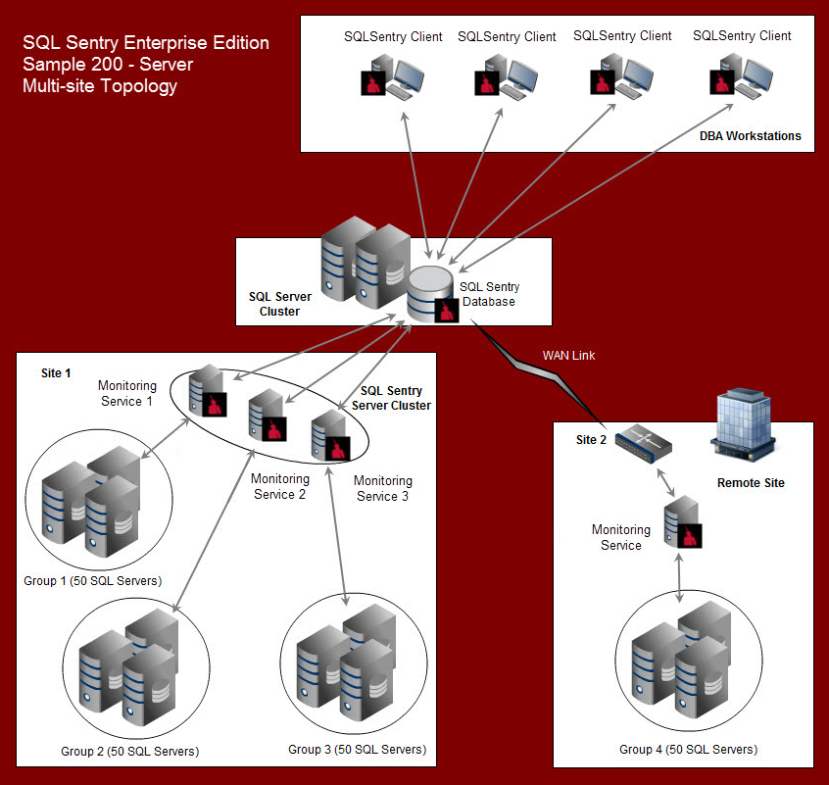
Agentless Architecture
1 Monitoring Service for every 50-100 servers

Slide 5
Monitoring Tool Comparisons*
Features | Ignite | SQL Sentry | Idera DM
Cost | $1800/instance | $1495/instance | $2049/instance
User Interface | Web | Desktop | Desktop/Mobile
Deadlock Monitor | No | Yes | Yes
Historical Logs | Yes | Yes | Yes
Lock/Block Monitor | Yes (custom) | Yes | Yes
Alerts | No | Yes | Yes
Query Tuning | No | Yes – Detailed | Yes – Basic
Replication Monitor | No | Yes | Yes
Approx. Overhead | 3%-4% | 0.25%-0.5% | 2%-3%
* Data Compiled in 2011

Slide 6
SQL Sentry Demo
To the tool!

Slide 7
Summary
Analyze your needs, review monitoring options
Use database monitors to troubleshoot emergencies as well as eliminate issues before they become problems
Get the free SQL Sentry Plan Explorer at: http://www.sqlsentry.net/plan-explorer
Upgrade to the Pro version for $95 (usually $295) at: http://www.sqlsentry.net/promo (use code PRO95)
Get free SQL tools at: http://www.johnsansom.com/top-10-free-sql-server-tools/
Contact information: Kevin Howell (khowell@sqlpsi.com)

