Slide 1
Supercharge Your Multi-Record Procedures with Table-Valued Parameters
Kevin Howell
khowell@sqlpsi.com
July 2015

Slide 2
Topics
What?
Why?
How?

Slide 3
What
SQL Server, User-Defined Type
Technique to pass multiple rows of data to procedure
Introduced in SQL 2008
Based on strongly-typed table structures in SQL Server

Slide 4
Why
To STOP iterative calls to the database

Slide 5
Why
To REPLACE XML packaging & parsing
Package Into XML
Parse XML
Parse XML
Package Into XML

Slide 6
Why
To EXPEDITE debugging of code AND procedures
<Employees>
<EmployeeID>120</EmployeeID>
<FirstName>Joe</FirstName>
<LastName>Smith</LastName>
</Employees>
<Employees>
<EmployeeID>124</EmployeeID>
<FirstName>Sally</FirstName>
<LastName>Jones</LastName>
</Employees>
XML
EmployeeID | FirstName | LastName
120 | Joe | Smith
124 | Sally | Jones
TVP

Slide 7
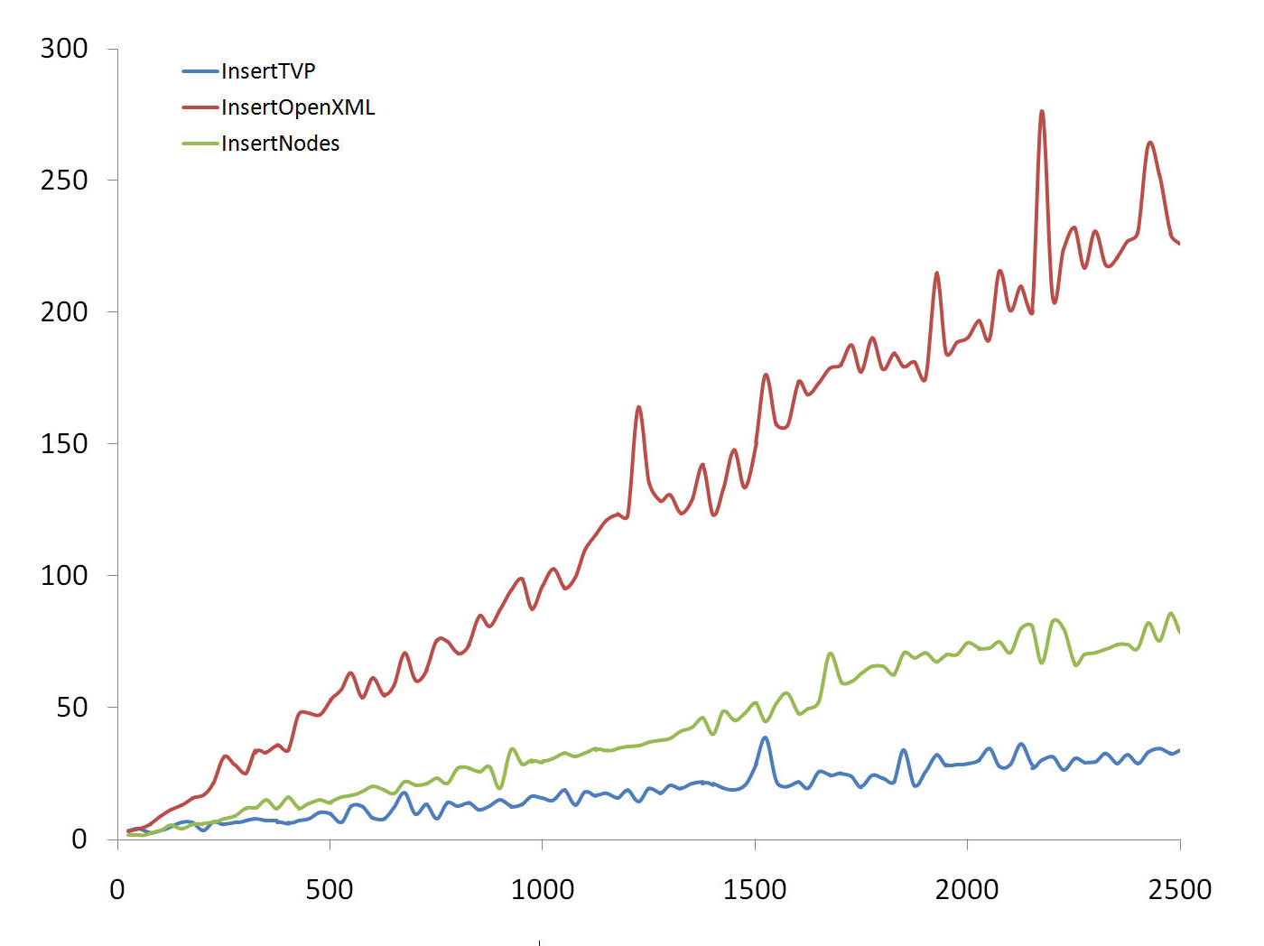
Why
To SPEED up procedures
TIME
# RECORDS

Slide 8
Demo

Slide 9
How (to Create)
Database
Create User-Defined Table Type
Grant Permissions on the Table Type
Create/Modify Procedure to use Table Type
Code
Create a DataTable definition that represents the Table Type
Fill the DataTable from existing collection
Pass the DataTable into the Stored Procedure

Slide 10
How (to Change)
Database Schema Changes
Open Procedure(s) in SSMS
Change the ALTER to CREATE
Drop the Procedure
Drop and create the Table Type (with changes)
Re-create the procedure (with changes)

Slide 11
Resources
MSDN – Table-Valued Parameters
USLI - TVP Basic Instructions
The Trouble with Type Tables

Slide 12
Questions?
Notes:
Corporate Structure, Subsidiary of Berkshire Hathaway

